Slide 1

Lesson 01
In-dept: Activities

Slide 2
Activities
An Android activity is one screen of the Android app's user interface.
An Android app may contain one or more activities.

Slide 3
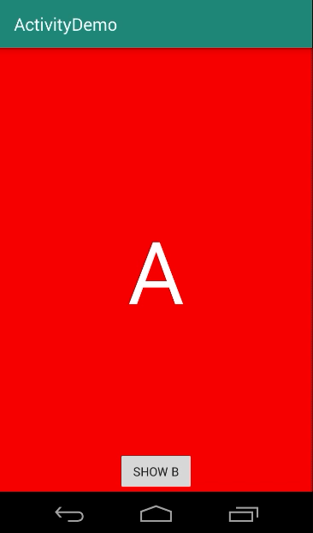
Activities
An Android activity is one screen of the Android app's user interface.
An Android app may contain one or more activities.

Slide 4
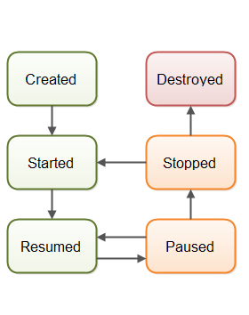
Activity Lifecycle
Any Android activity goes through a certain life cycle during its life inside the Android app

Slide 5
Activity Lifecycle
onCreate() You must implement this callback, which fires when the system creates your activity. Your implementation should initialize the essential components of your activity. Most importantly, this is where you must call setContentView() to define the layout for the activity's user interface.

Slide 6
Activity Lifecycle
onStart() As onCreate() exits, the activity enters the Started state, and the activity becomes visible to the user. This callback contains what amounts to the activity’s final preparations for coming to the foreground and becoming interactive.

Slide 7
Activity Lifecycle
onResume() The system invokes this callback just before the activity starts interacting with the user. At this point, the activity is at the top of the activity stack, and captures all user input.

Slide 8
Activity Lifecycle
onPause() The system calls onPause() when the activity loses focus and enters a Paused state. This state occurs when, for example, the user taps the Back or Recents button. When the system calls onPause() for your activity, it technically means your activity is still partially visible, but most often is an indication that the user is leaving the activity, and the activity will soon enter the Stopped or Resumed state.

Slide 9
Activity Lifecycle
onStop() The system calls onStop() when the activity is no longer visible to the user. This may happen because the activity is being destroyed, a new activity is starting, or an existing activity is entering a Resumed state and is covering the stopped activity. In all of these cases, the stopped activity is no longer visible at all.

Slide 10
Activity Lifecycle
onRestart() The system invokes this callback when an activity in the Stopped state is about to restart. onRestart() restores the state of the activity from the time that it was stopped.

Slide 11
Activity Lifecycle
onDestroy() The system invokes this callback before an activity is destroyed.

Slide 12
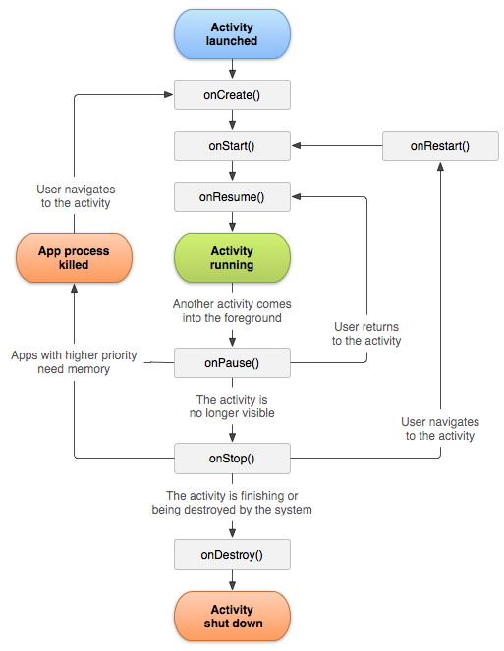

Slide 13
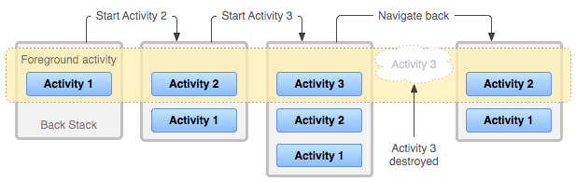
Activities Back Stack
The activities are arranged in a stack (back stack) in the order in which each activity is opened.

Slide 14
Hands-on

Slide 15
What you will learn
Basic views: EditText
Passing Data between activities.
Basic Theming
Image View

Slide 16
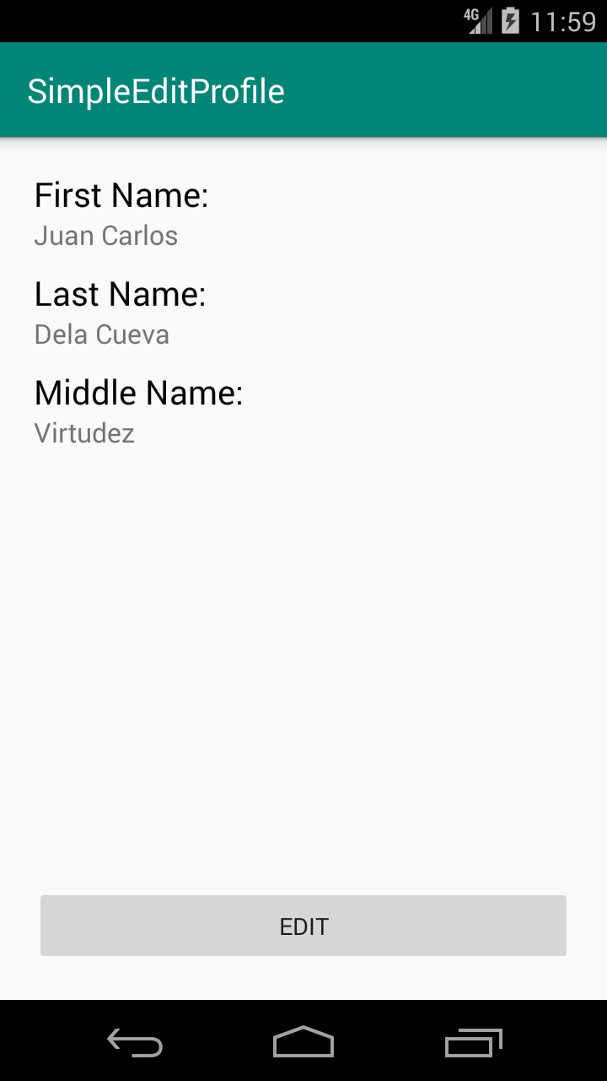
Simple Edit Profile
Show user full name
Ability to edit the info

Slide 17
Machine Problem #2

Slide 18

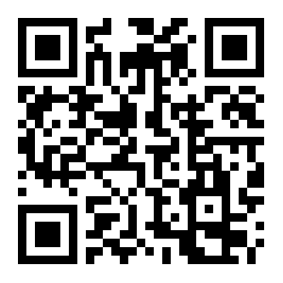
Have a good day!
https://github.com/JcDelaCueva/nu-calamba-lessons

